Slide 1

Stock Market Crash Analysis
Hayden Buss, Matthew Skinner, Andrew McKinney, Joe Hnat

Slide 2
Motivation and Summary
Between the members in our group, we were all interested in economics and given our employment with public companies and love for money, understanding what stocks and industries were hit hardest in crashes were of great interest to us.
We decided to look at the Top 5 and Bottom 5 performing stocks as well as their respective industries to see who fared the best/worst during bad times and vice versa.
We were able to answer the questions and the answers are in the charts on the following slides.

Slide 3
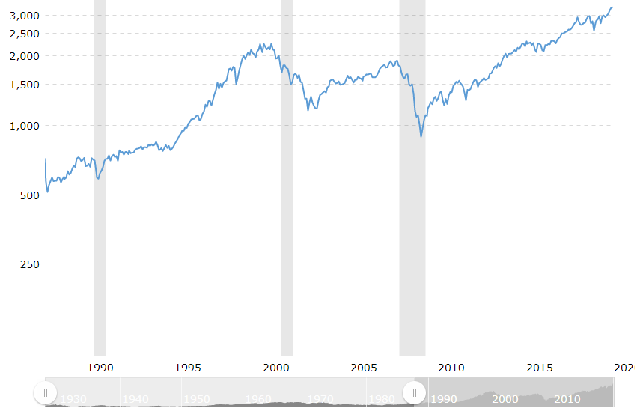
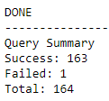
Data Cleanup & Exploration
API Data Limitations Reduced Recession Period Available
Costly / Difficult APIs
Call Limitations to 5 per minute
S&P 500 List -> Fortune 500 List
Recession Time Frame Cut Short
Start Date to Index Trough
Removed Recovery Period
Stocks Not Spanning Analysis Removed
New Stocks
Split Companies
Project Deadline Limited Analyses
Larger Sample Size (S&P 500)
Pre-Recession Stock Strength vs Changes
Lack of Industry Data in Original Dataset
Had to manually locate / enter this data
Limitations of Dataset Quantity
Biased Industry Analysis (See Industry Pie Chart)
KEY:
Green: Data Time Span Desired
Grey: Definitive Recession Time Frame
Red: Analysis Recession Time Frame
Blue: Analysis Time Span
Source: https://www.macrotrends.net/2324/sp-500-historical-chart-data

Slide 4
!!!WELCOME TO GITHUB!!! - Data
Collection & Munging of:
Fortune 100 List
Symbol List
Query List Creation
Industry Data
Check out my Git, bro:
https://github.com/skinnms/DBC_project_1/tree/master/Scripts

Slide 5
Data Analysis
Discuss the steps you took to analyze the data and answer each question you asked in your proposal
We shifted the timeline of each recession back 3 months in order to get an accurate picture of the peak and valley of each stock
Measured the difference of each stock using the last month of the recession vs. the first month of the recession
Took the top 5 performing companies (most positive gain) and bottom 5 companies (least positive gain)
Measured across all industries included in the data set
Present and discuss interesting figures developed during analysis, ideally with the help of Jupyter Notebook
Data Analysis Code

Slide 6
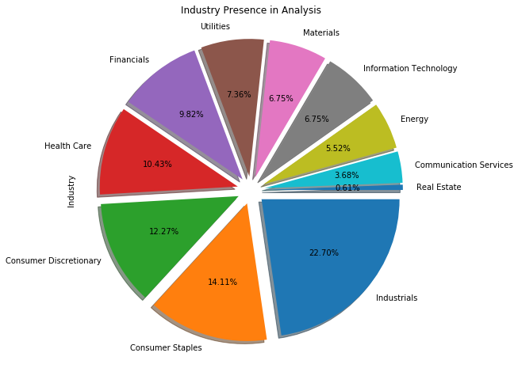
Discussion
Discuss your findings. Did you find what you expected to find? If not, why not? What inferences or general conclusions can you draw from your analysis? What does it mean?
The stocks and industries changed between each recession of what was hit the hardest
Change in factors like consumer taste and discretionary spending were not considered which could’ve had an impact on the change in stock price over the recession.
Above is a chart of the breakdown by industry and the percentage of what they made up in our data. One limitation was the Real Estate section as there was only one company so the industry change will be skewed as it is not a large enough sample.

Slide 7
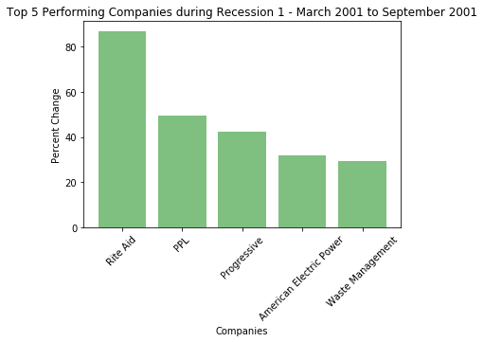
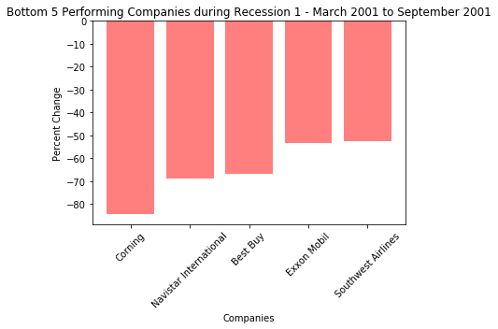
Question 1: What were the top and bottom 5 stocks that were affected by the .Com recession?

Slide 8
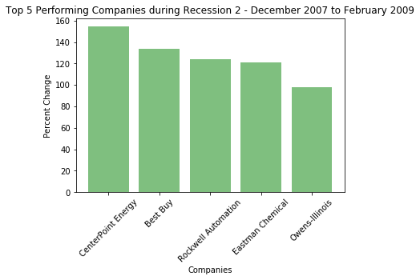
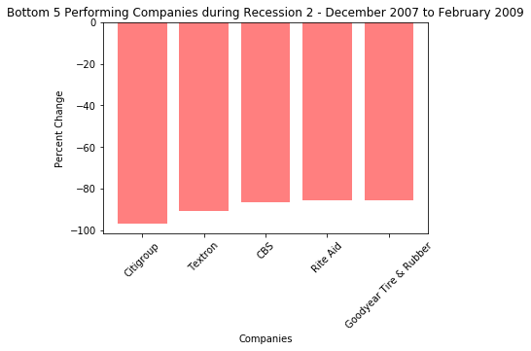
Question 2: What were the top and bottom 5 stocks that were affected by the 2008 Financial Crisis?

Slide 9
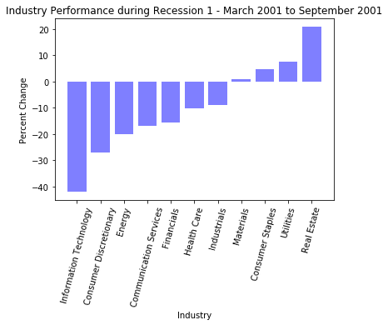
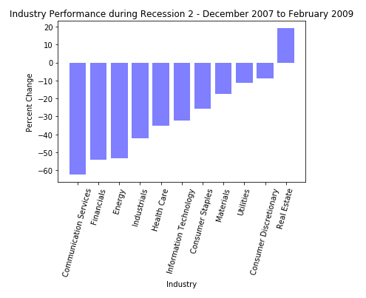
Question 3: What were the top and bottom industries that were affected during both recessions?

Slide 10
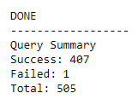
Post Mortem
Discuss any difficulties that arose, and how you dealt with them
Limited number of free stock data
The size of the stock data to use while consciously keeping API key calls under the minimum
What stocks had enough data for the time period we were pulling for
Incomplete tickers and having to find and replace them
Finding what industry and putting it back into the frame to have better groups for graphs
Stock data is broad and knowing exactly where to focus n to get a decent representation of crashes (deciding on just the S&P500)
Discuss any additional questions that came up, but which you didn't have time to answer: What would you research next, if you had two more weeks?
The variability of each industry based on the stocks that made them up
MEasuring which stocks bounced back the highest in the recovery periods vs. those that never recovered
Seeing what policies were used to combat the crash
See which industries decided to put in more precautions to better prepare for another
Expanding the history and length of the research to see DOW, NASDAQ, S&P, Foreign stocks to see any global effects nd/or how to the U.S. crashes affected the global markets

Slide 11
Questions?

